Slide 1
STM32 Training IoT Module
August, 2021

Slide 2
Giới thiệu
MQTT Protocol Stack
ESP-LINK Integration
Setup Mosquitto Broker
Setup MQTT Client Box

Slide 3
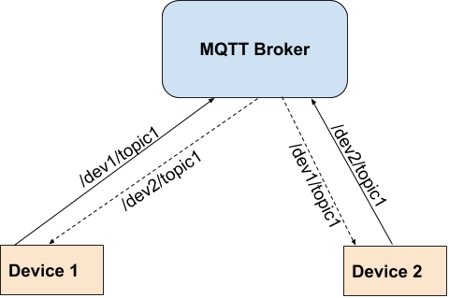
MQTT Protocol
MQTT = Message Queuing Telemetry Transport

Slide 4
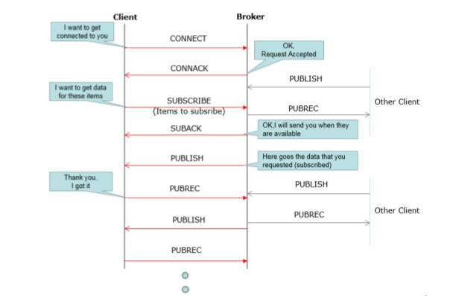
MQTT - Message Flow

Slide 5
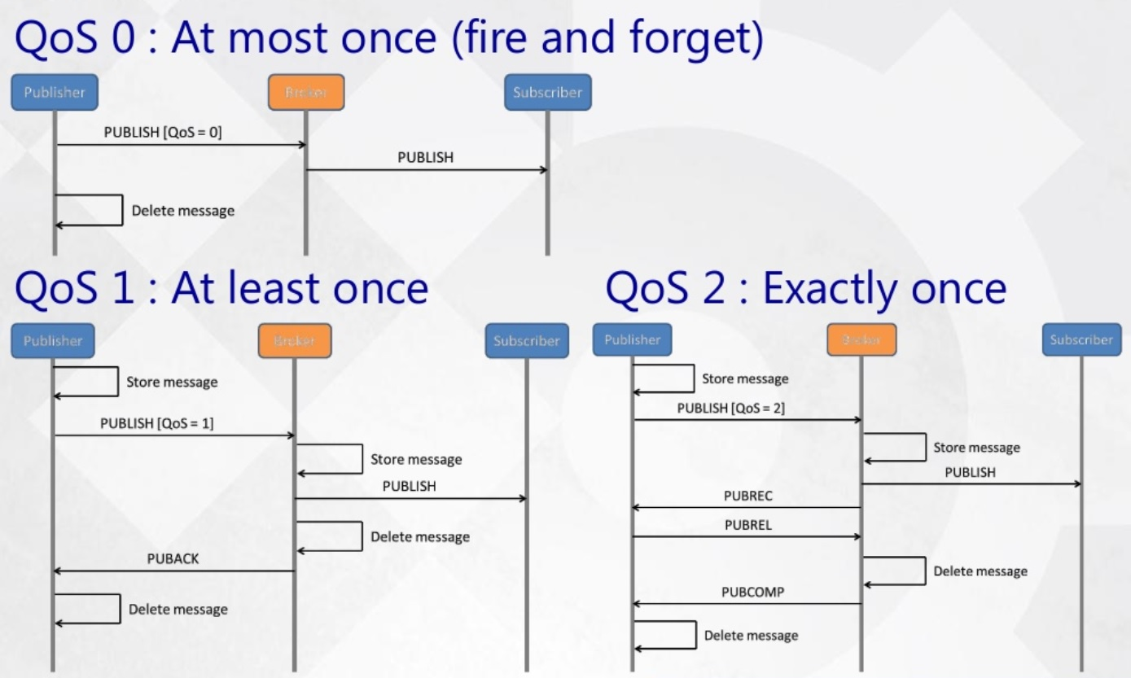
MQTT - QoS (Quality of Service)

Slide 6
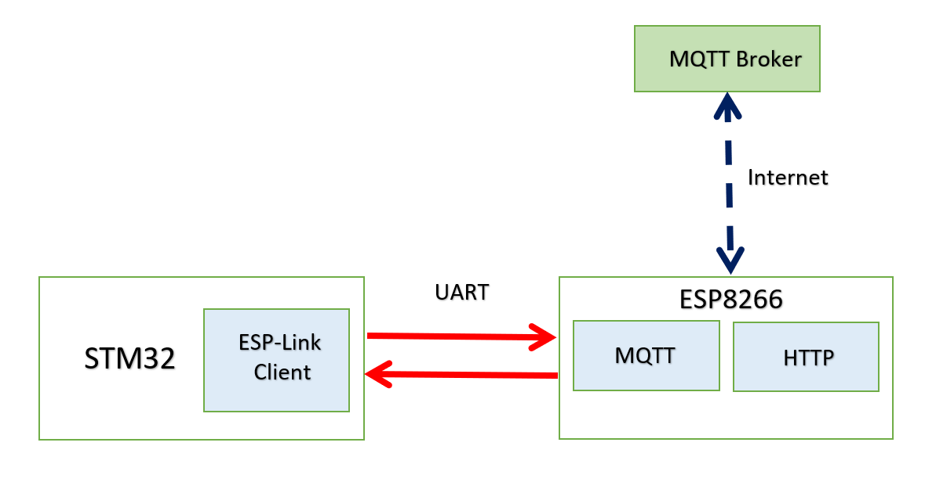
ESP-LINK STM32 Integration

Slide 7
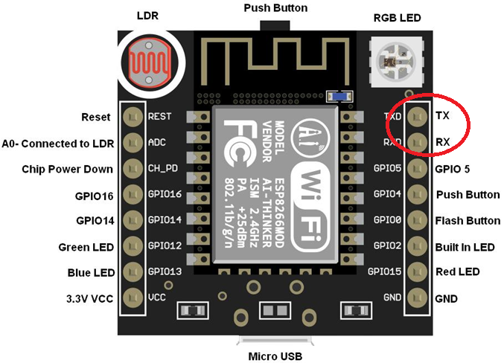
ESP Module

Slide 8
ESP-Link Firmware
ESP-Link
https://github.com/jeelabs/el-client
Prequisite:
- Python 3 (3.7, 3.8, 3.9)
- Install esptool.py
python .\setup.py build
python .\setup.py install
OR
pip install esptool

Slide 9
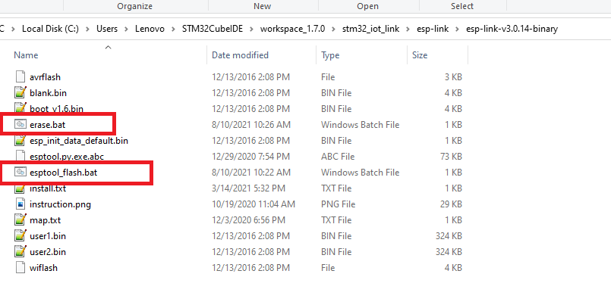
Command line tool
Edit COM Port
esptool.py --port COM14 erase_flash

Slide 10
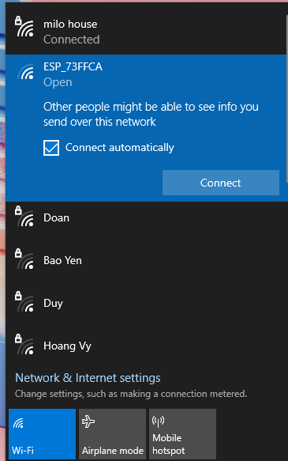
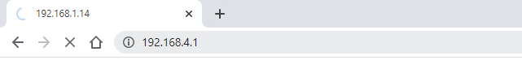
ESP-Link: Setup Wifi
Step 1: join ESP AP Wifi – press Connect
Open Browser ESP’s IP:
192.168.4.1

Slide 11
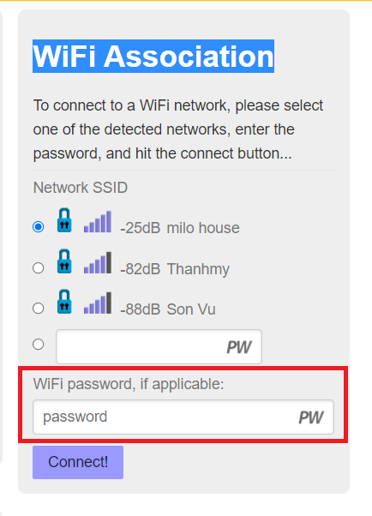
Setup Station Mode

Slide 12
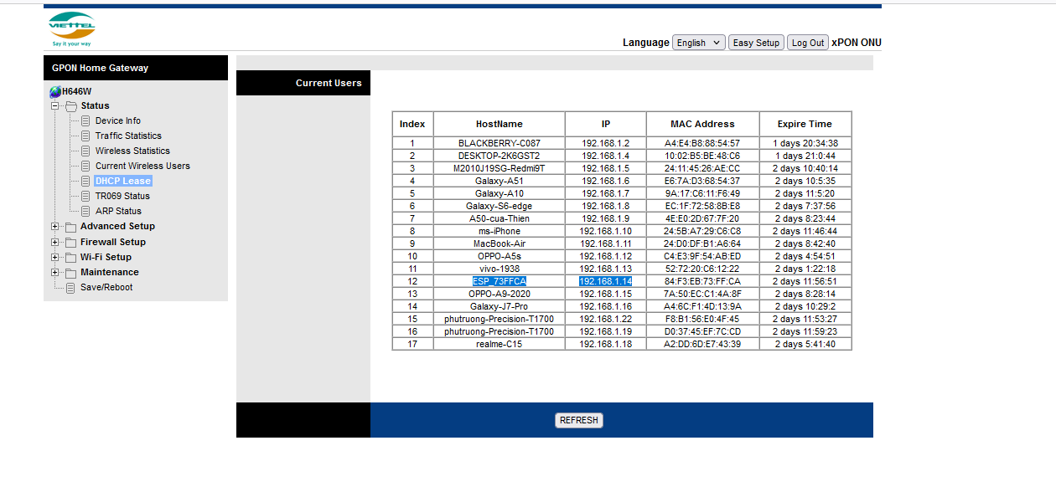
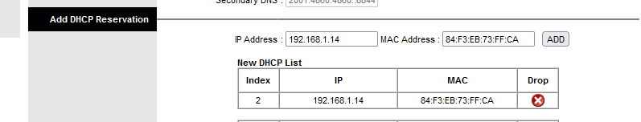
Modem setting

Slide 13
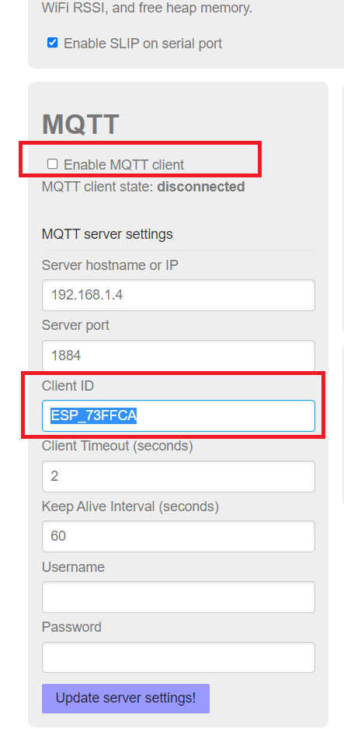
Setup MQTT Link
Reboot after changes

Slide 14
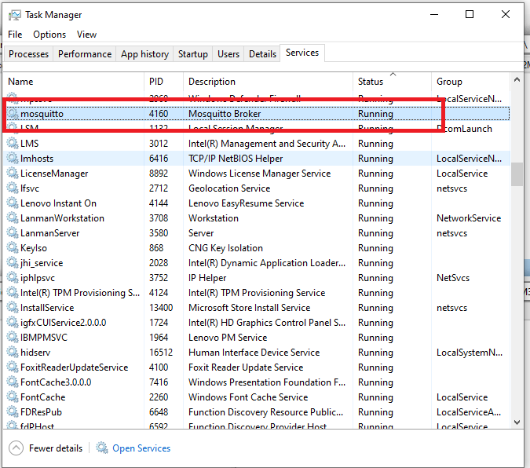
Cài đặt MQTT Broker
Chú ý: Mở Task Manager, tìm server “mosquito” sau đó click chuột phải, nhấn Stop trước khi chạy.

Slide 15
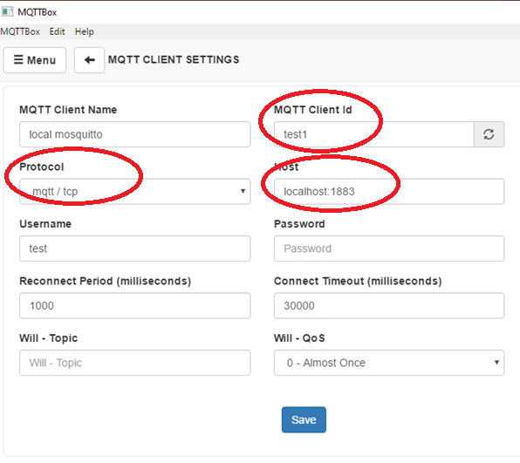
Cấu hình MQTTBox
127.0.0.1:1884

Slide 16
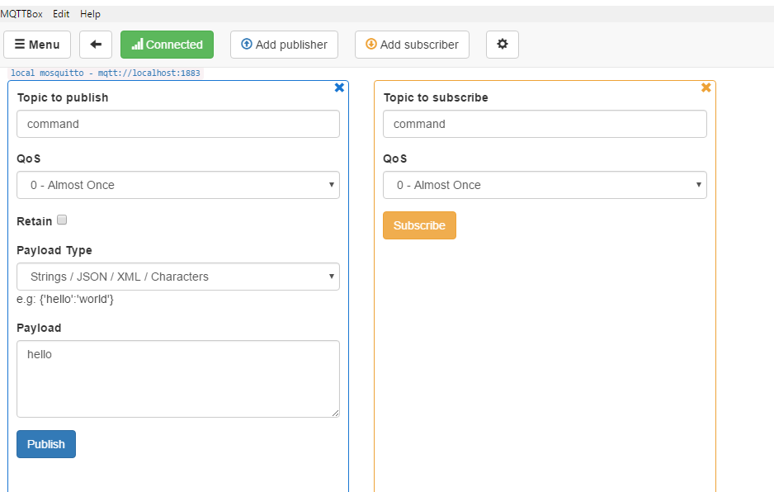
Pub/Sub dùng MQTTBox
Chú ý:Các client phải cùng publish/subscribe trên cùng 1 topic name mới có thể gửi/nhận dữ liệu với nhau.

Slide 17
Reference Resources
1. Hướng dẫn cài đặt mosquito broker
https://m2msupport.net/m2msupport/install-mqtt-broker-mosquitto-in-windows/
2. MQTT protocol
https://m2msupport.net/m2msupport/how-mqtt-works/

Slide 18
SLIP = Serial Line IP

Slide 19
THANK YOU!

